Slide 1

Distributed Artificial Intelligence
Multi-agent reinforcement learning in openAI gym
Progetto di Fabio Polito

Slide 2
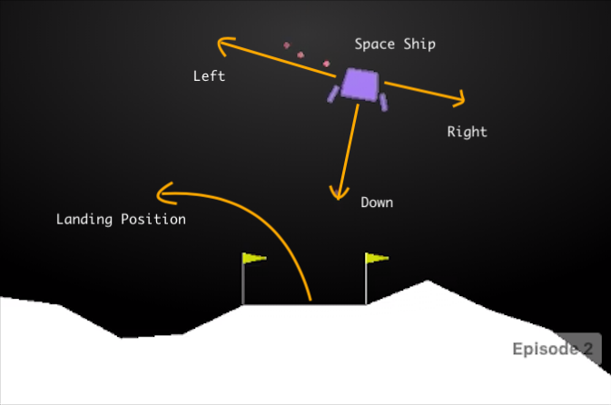
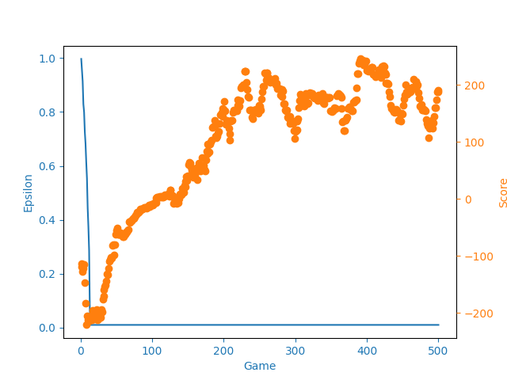
Primo approccio
Singolo agente
Deep reinforcement learning

Slide 3

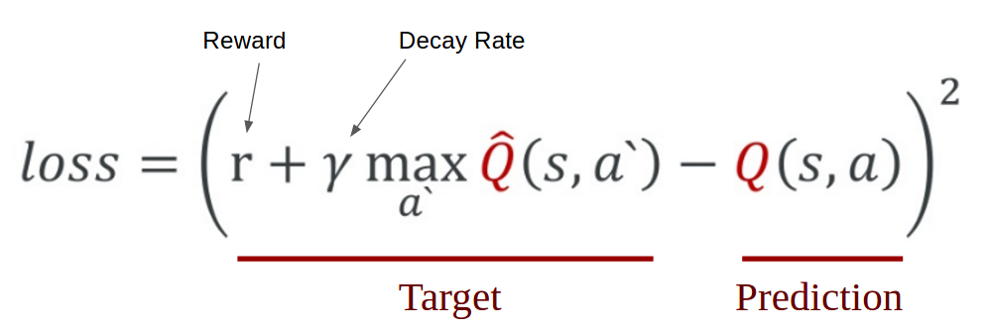
Algoritmo di learning
Experience Replay:
Il sistema memorizza i dati ad ogni step in una
memoria interna [state, action, reward, next_state]
per ridurre la correlazione tra i campioni.
Notes:
What does the above statement mean? Instead of running Q-learning on state/action pairs as they occur during simulation or the actual experience, the system stores the data discovered for [state, action, reward, next_state] – in a large table.
Let’s understand this using an example.
Suppose we are trying to build a video game bot where each frame of the game represents a different state. During training, we could sample a random batch of 64 frames from the last 100,000 frames to train our network. This would get us a subset within which the correlation amongst the samples is low and will also provide better sampling efficiency.

Slide 4

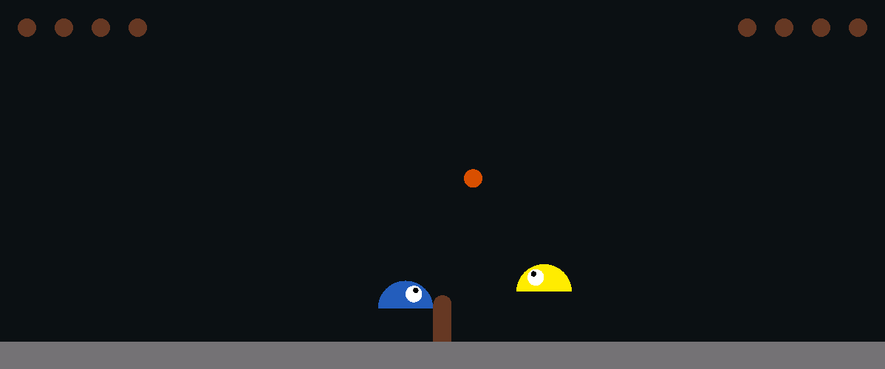
Slime Volleyball Gym Environment

Slide 5
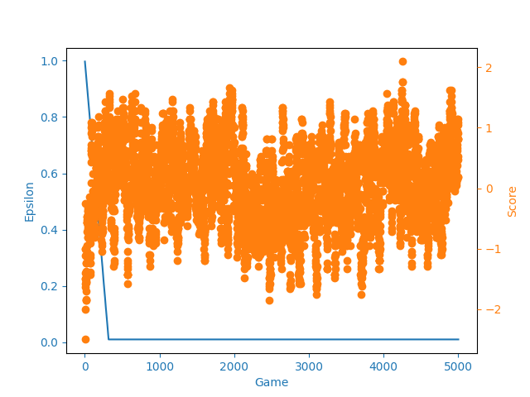
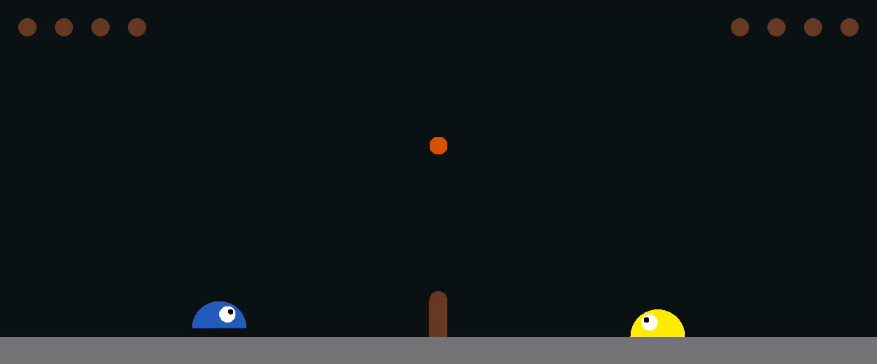
Primi risultati
Self-play:
Garantisce che l’ambiente sia alla giusta difficoltà per permettere all’agente di migliorare.
Notes:
Self-play ensures that the environment is always the right difficulty for an AI to improve

Slide 6
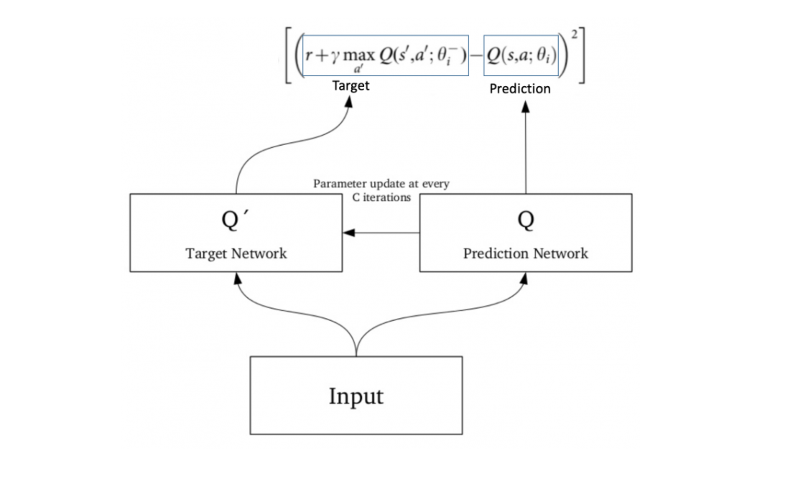
Double Deep Q Network
Notes:
Taking the maximum overestimated values as such is implicitly taking the estimate of the maximum value. This systematic overestimation introduces a maximization bias in learning. And since Q-learning involves bootstrapping — learning estimates from estimates — such overestimation can be problematic.
As we can see, traditional DQN tends to significantly overestimate action-values, leading to unstable training and low quality policy:
The solution involves using two separate Q-value estimators, each of which is used to update the other. Using these independent estimators, we can unbiased Q-value estimates of the actions selected using the opposite estimator [3]. We can thus avoid maximization bias by disentangling our updates from biased estimates.
. For every C iterations (a hyperparameter), the parameters from the prediction network are copied to the target network. This leads to more stable training because it keeps the target function fixed (for a while):

Slide 7
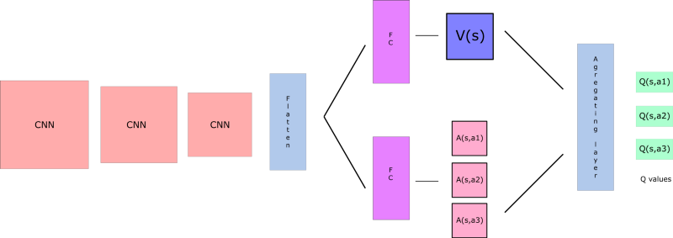
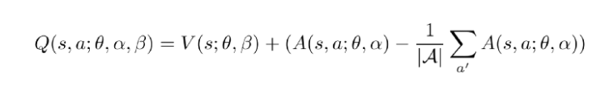
Dueling Deep Q network
Notes:
(Wang et al.) presents the novel dueling architecture which explicitly separates the representation of state values and state-dependent action advantages via two separate streams.
The key motivation behind this architecture is that for some games, it is unnecessary to know the value of each action at every timestep. The authors give an example of the Atari game Enduro, where it is not necessary to know which action to take until collision is imminent.
By explicitly separating two estimators, the dueling architecture can learn which states are (or are not) valuable, without having to learn the effect of each action for each state. Like the Enduro example, this architecture becomes especially more relevant in tasks where actions might not always affect the environment in meaningful ways.
Intuitively, the dueling architecture can learn which states are (or are not) valuable, without having to learn the effect of each action for each state. This is particularly useful in states where its actions do not affect the environment in any relevant way
In the experiments, we demonstrate that the dueling architecture can more quickly identify the correct action during policy evaluation as redundant or similar actions are added to the learning problem.

Slide 8
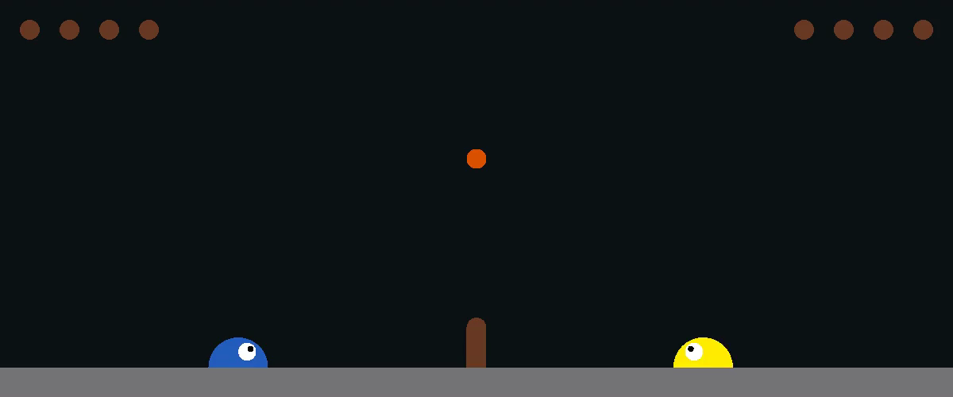
Risultati ambiente competitivo
Media Punteggio:
0,30
Media Timesteps:
3000

Slide 9
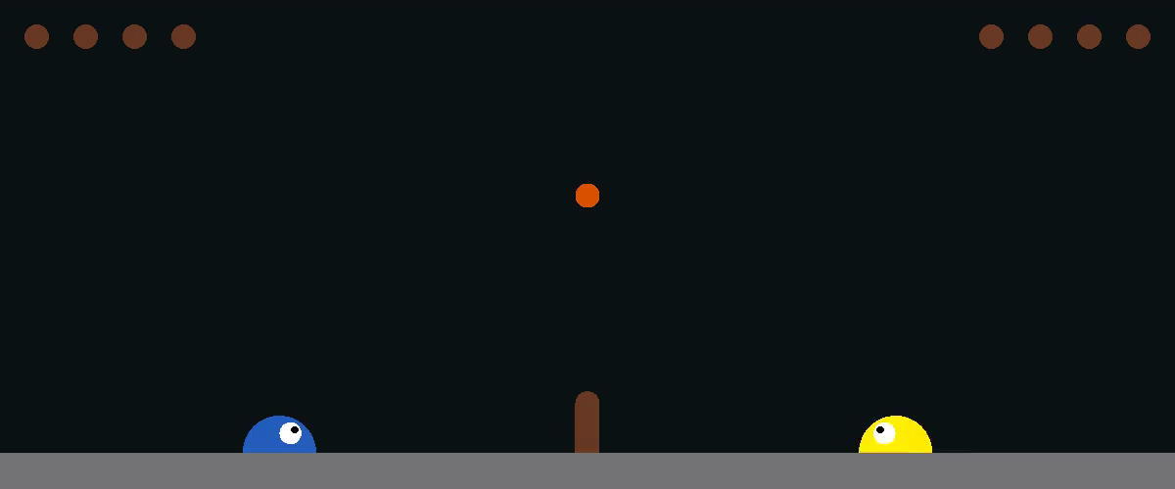
Modalità cooperativa
Riadattamento dei rewards per modificare l’obbiettivo degli agenti

Slide 10
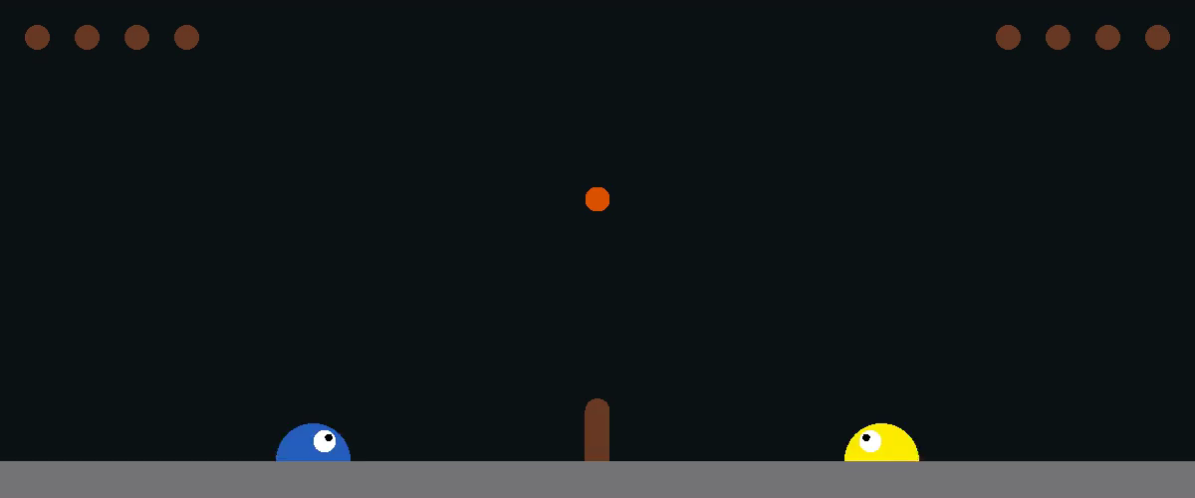
Aggiornamento rewards
Correzione dei rewards per stimolare comportamenti collaborativi tra gli agenti

Slide 11
Competitivo - Cooperativo

Slide 12
Conclusioni
Complessità
Sistemi
Multiagente
Problema dell’esplosione degli stati
Importanza
dei
reward

Slide 13
Grazie
per l’attenzione

